Slide 1
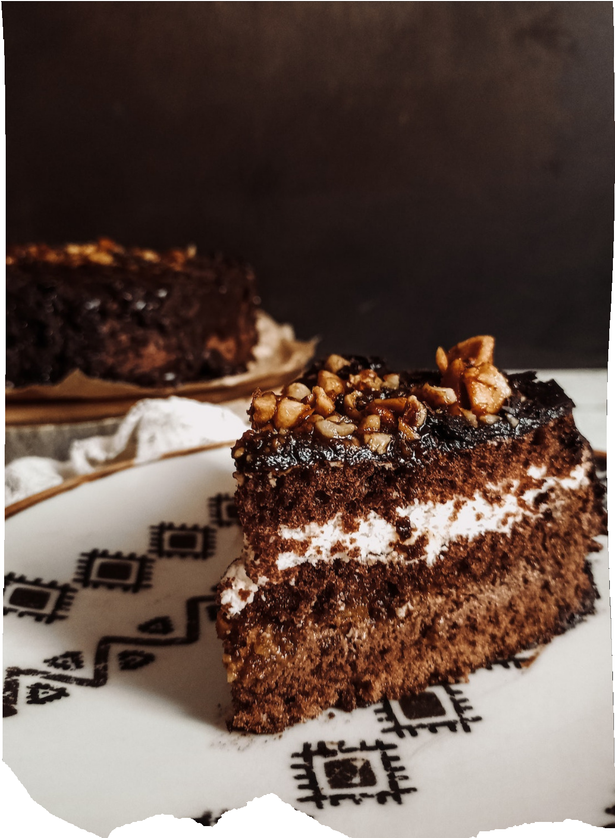
CAKE BUFFET
Cake, Cup Cake & Pastries
Sweetest Slice Of Paradise

Slide 2
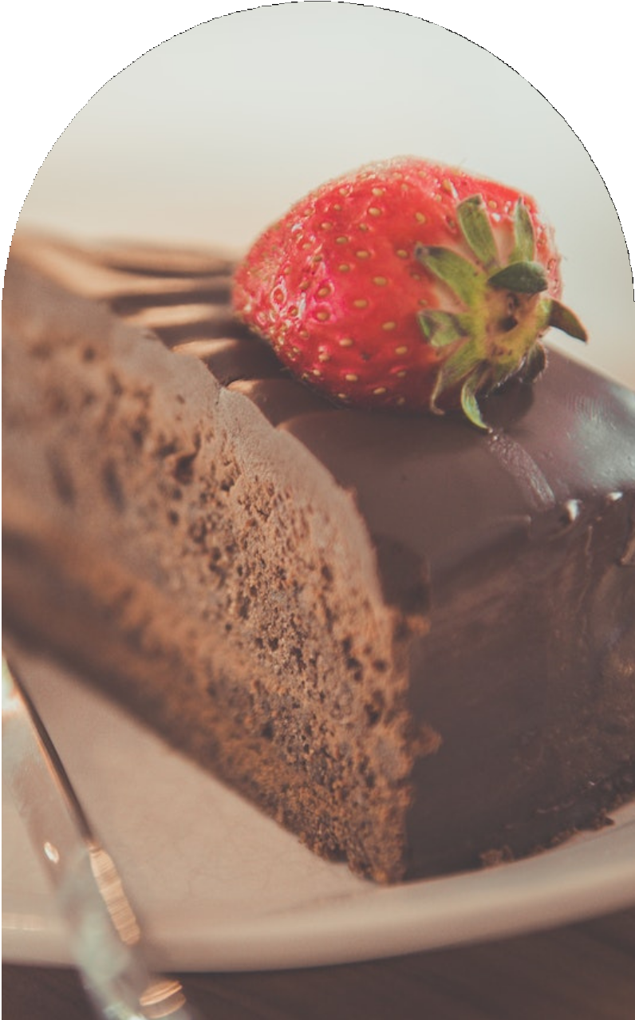
WHAT IS CAKE BUFFET ?
Online Cake Order is a web based application which enable customers to order cakes through web online.
As the internet users are increasing rapidly, online customize cake ordering system will help the customers to order the cake as per their choice.

Slide 3
1
2
DATABASE BASED REGISTRATION
Drag & Drop Customised Dashboard
Text & Images can be uploaded
BASIC FEATURES OF CAKE BUFFET
3
4 Highly secured Password authentication
5
Customer can add items to their cart for lator purposes
₆ Profile information like email bio & profile can be updated

Slide 4
HOW WE DELIVER BUSINESS VALUE?
Vision
To provide baked goods of exceptional quality to every household at a right and legit price.
Mission
Create a bakery that makes the best quality baked goods on-site from scratch,
fresh daily with a warm atmosphere for our clients and customers, even our employees to learn, grow and innovate

Slide 5
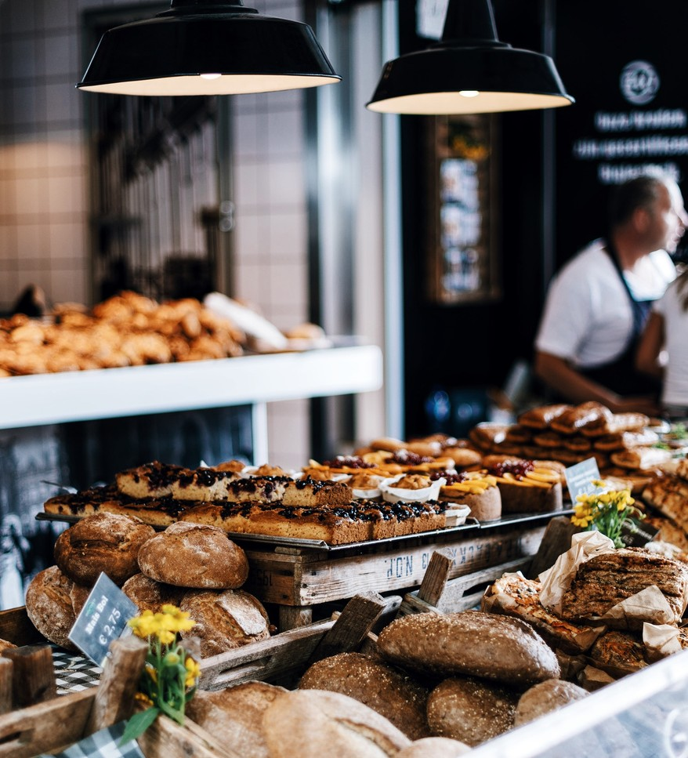
MARKETING STRATEGY
Loyalty Programs
Special programs for loyal customers, can be
discounts, coupons and so on
Social Media Marketing
Reach your customers online through
the social media
Efficiency
Improve employee work efficiency and services, both in stores and online

Slide 6
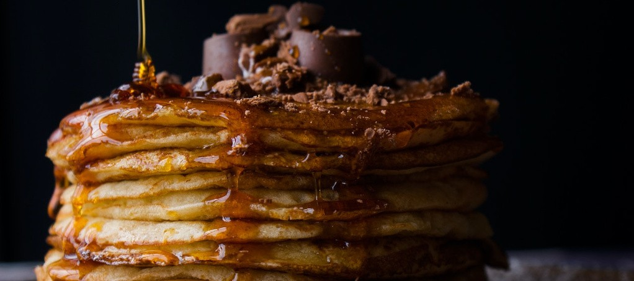
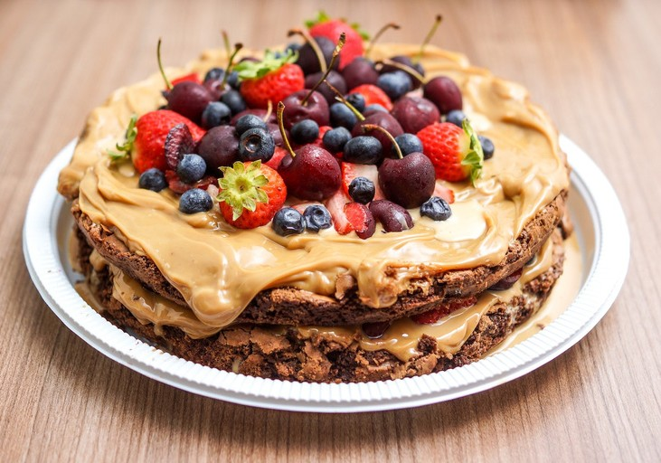
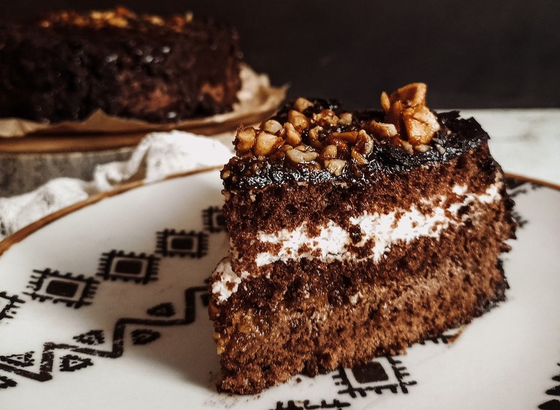
OUR FRESH BAKE
cake
Made from fresh ingredients using traditional cooking and baking techniques
Desserts
A pancake is a flat cake, often thin and round, prepared from a starch- based batter that may
Pastries
Enjoy a one-bite size treat to accompany your tea time
contain eggs, milk and butter and cooked on a hot
surface

Slide 7
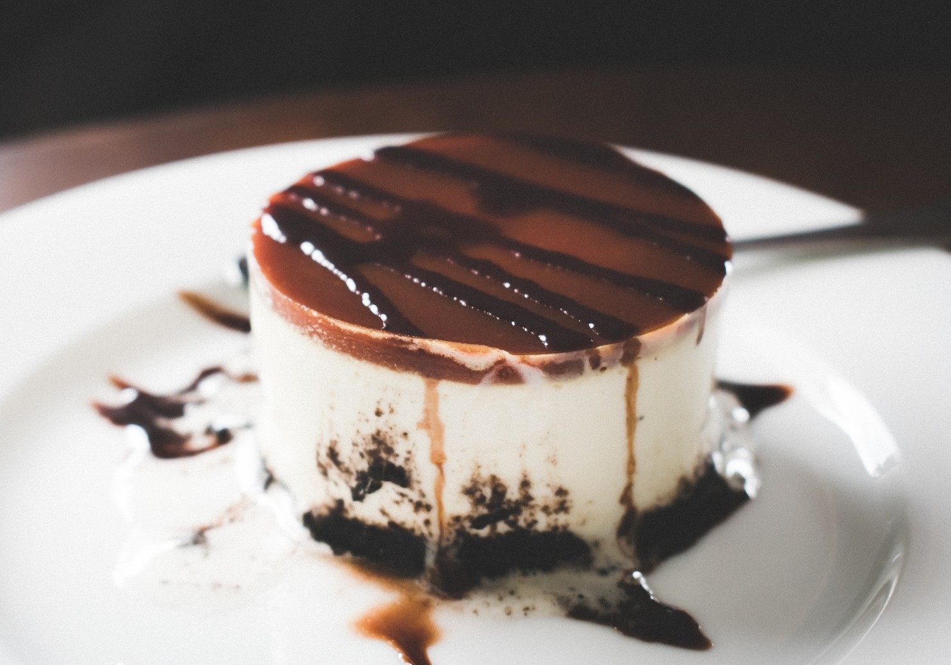
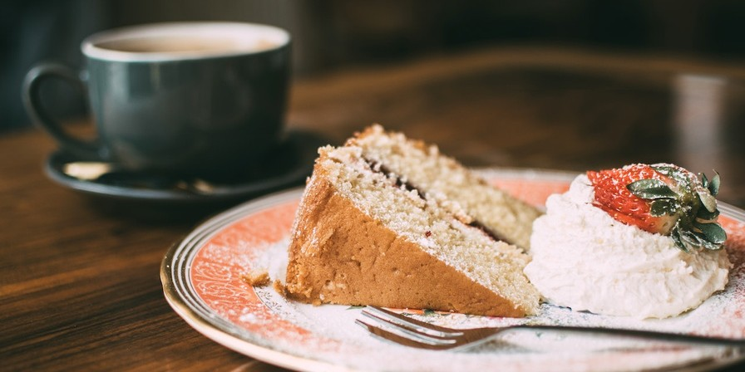
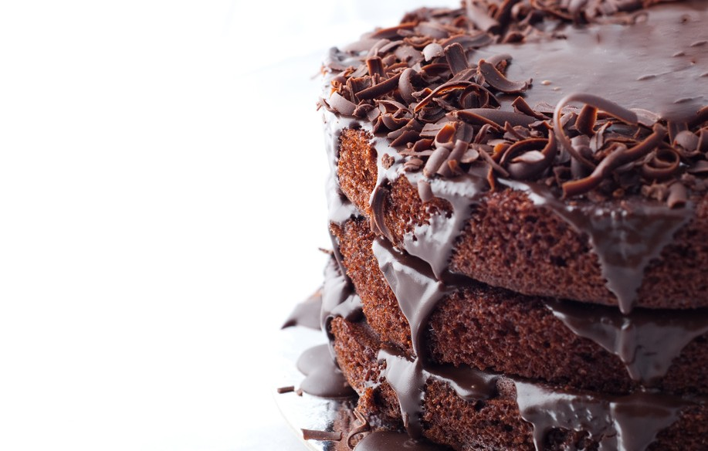
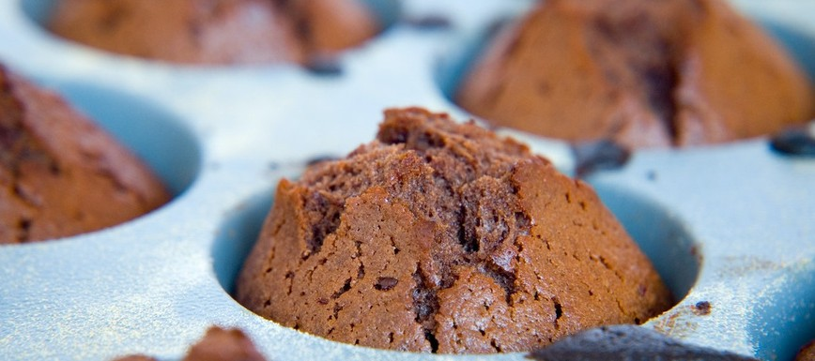
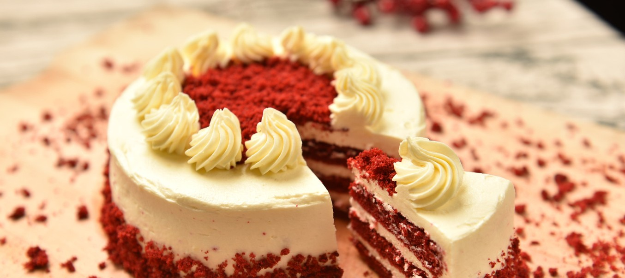
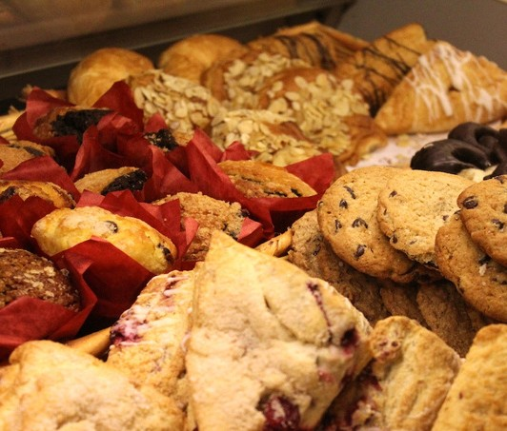
OUR POPULAR PRODUCTS
Several products in our shop which are in high demand by customers this month

Slide 8
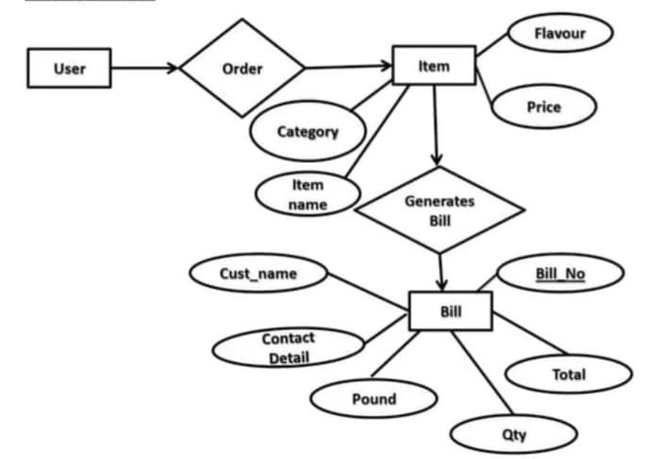
DATA FLOW DIAGRAM

Slide 9
1
2
3
HTML
CSS & BOOSTRAP JAVASCRIPT
TOOLS AND TECHNOLOGY
4 DJANGO
5
POSTGRESQL& SQL LITE
₆ Profile information like email bio & profile can be updated

Slide 10
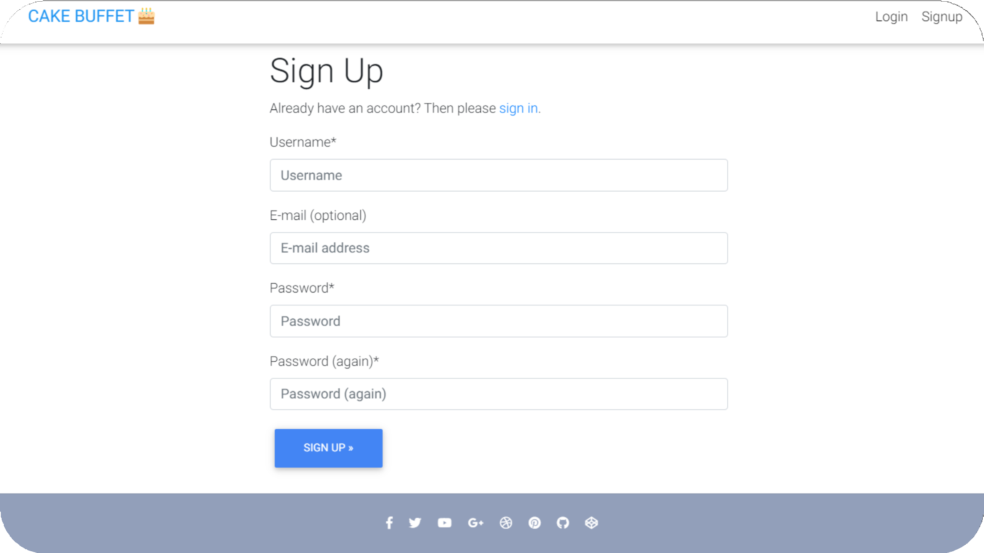
SIGNUP FORM

Slide 11
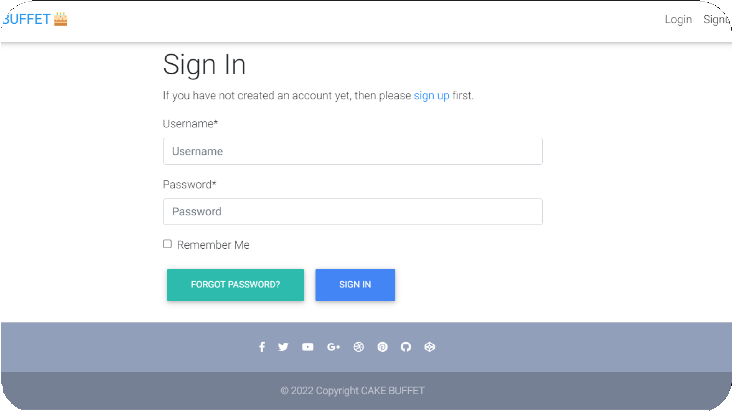
SIGN FORM

Slide 12
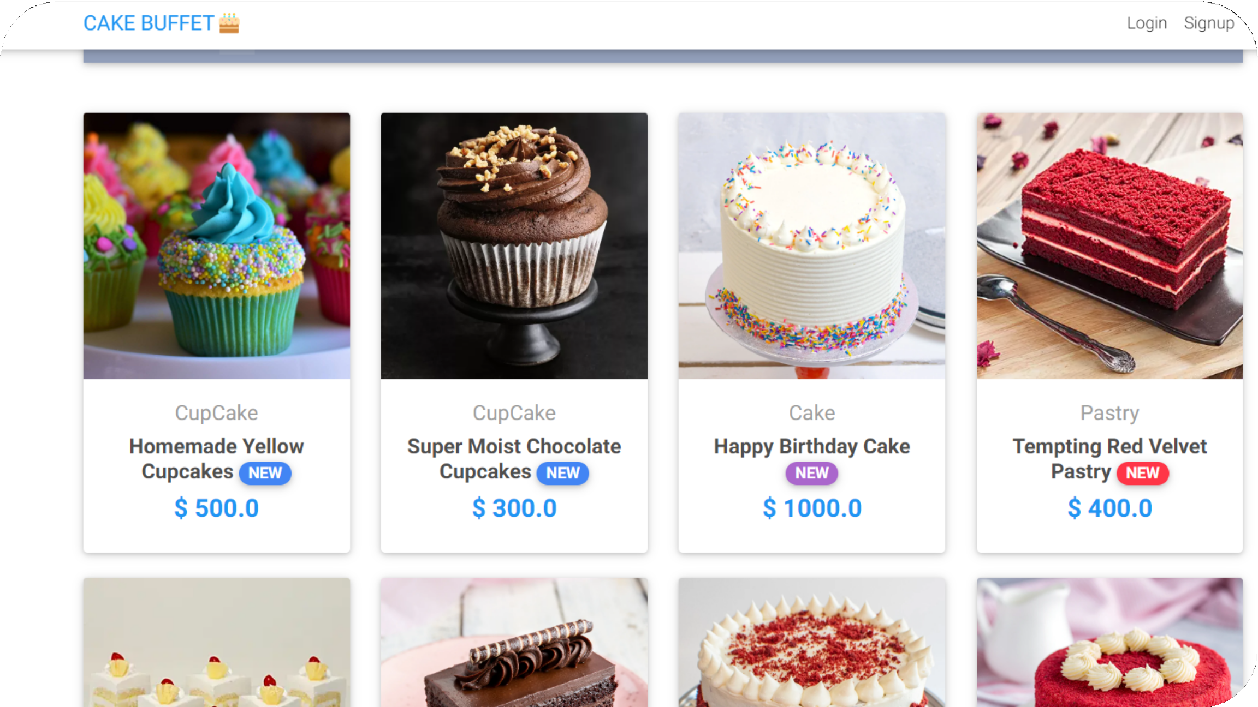
MAIN PAGE OF CAKE BUFFET

Slide 13
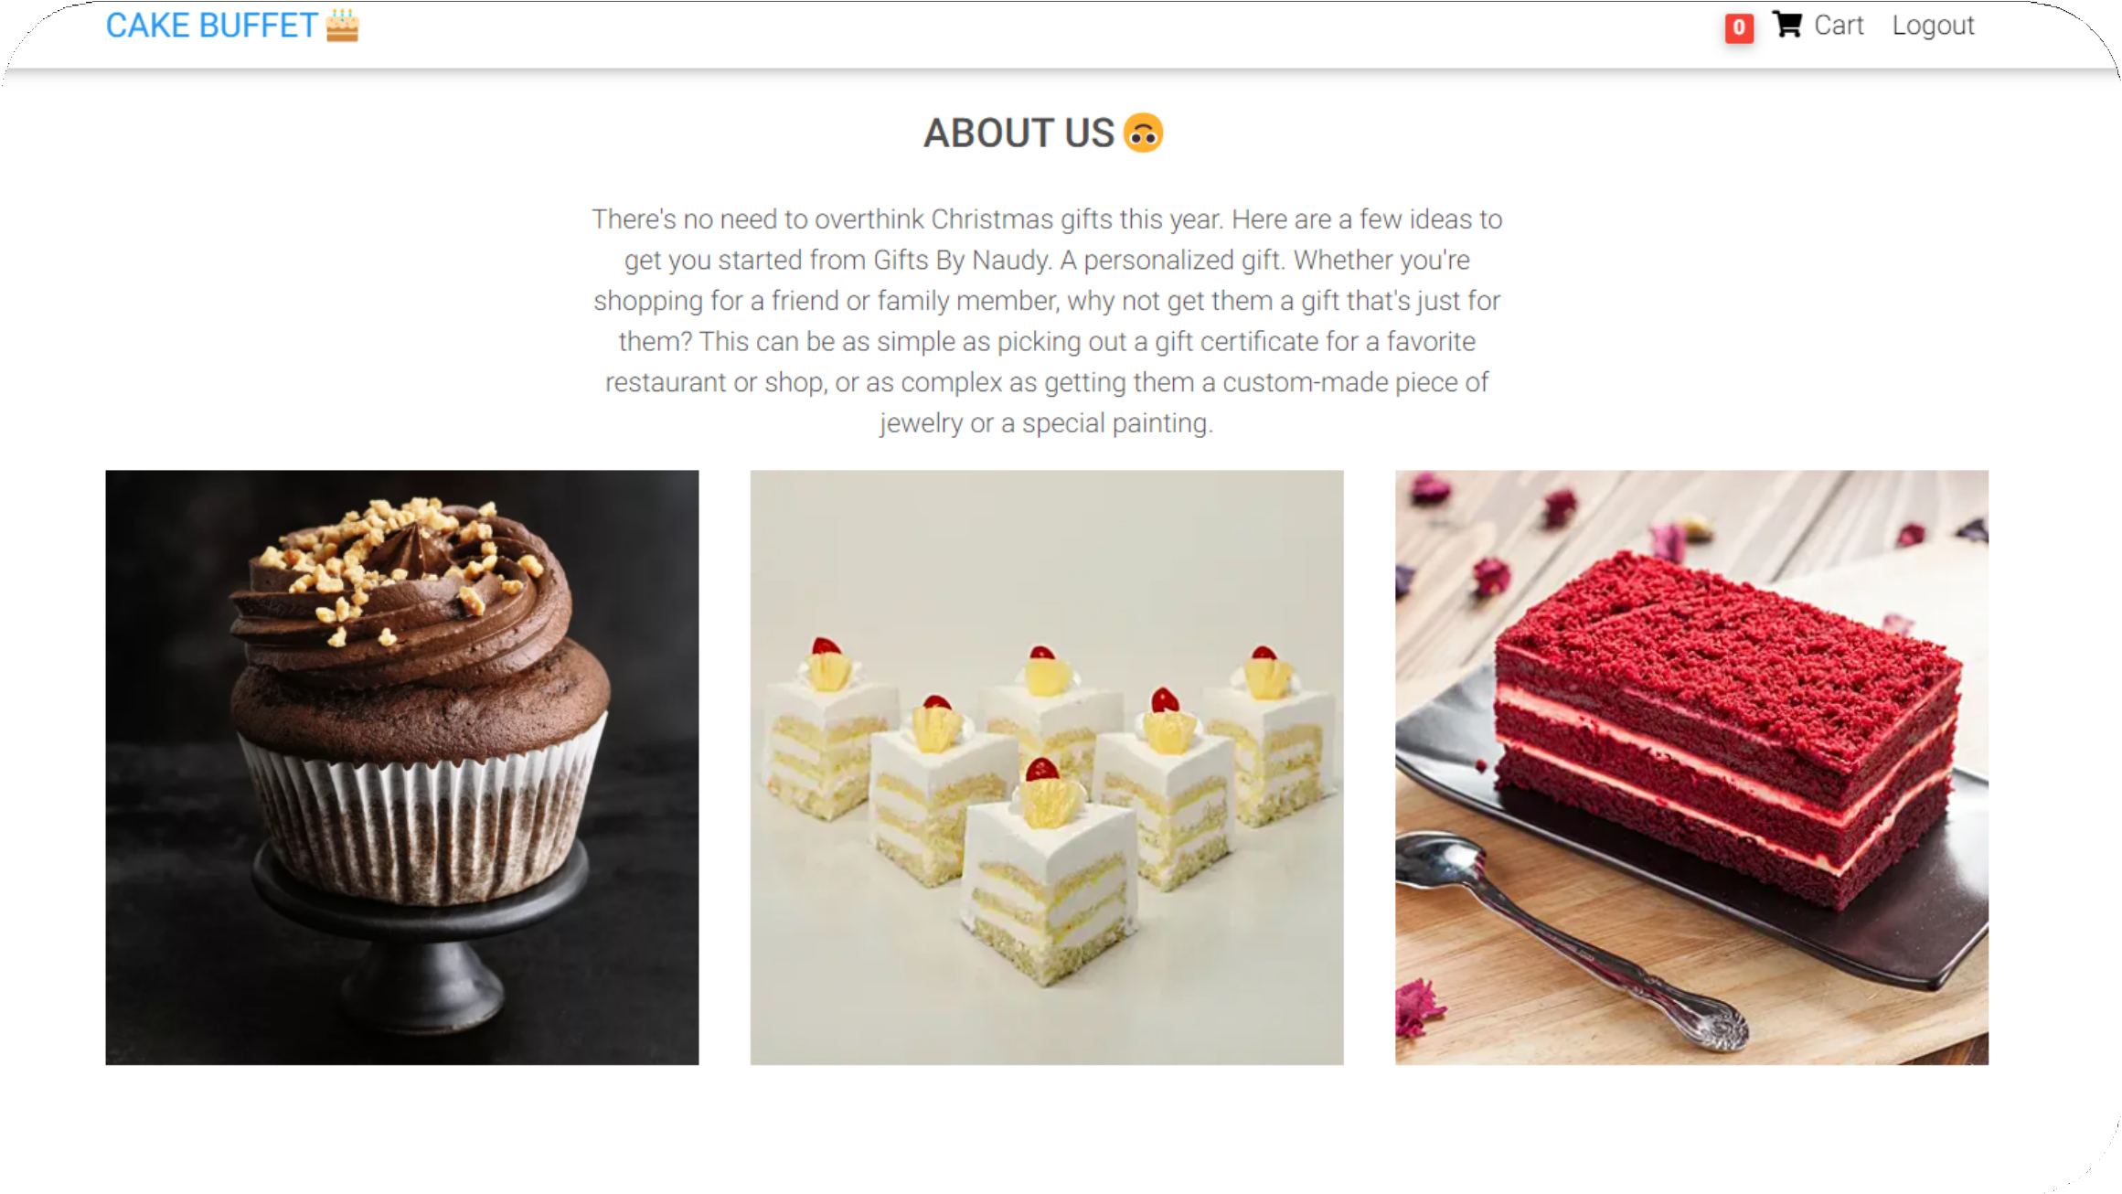
ABOUT
US

Slide 14
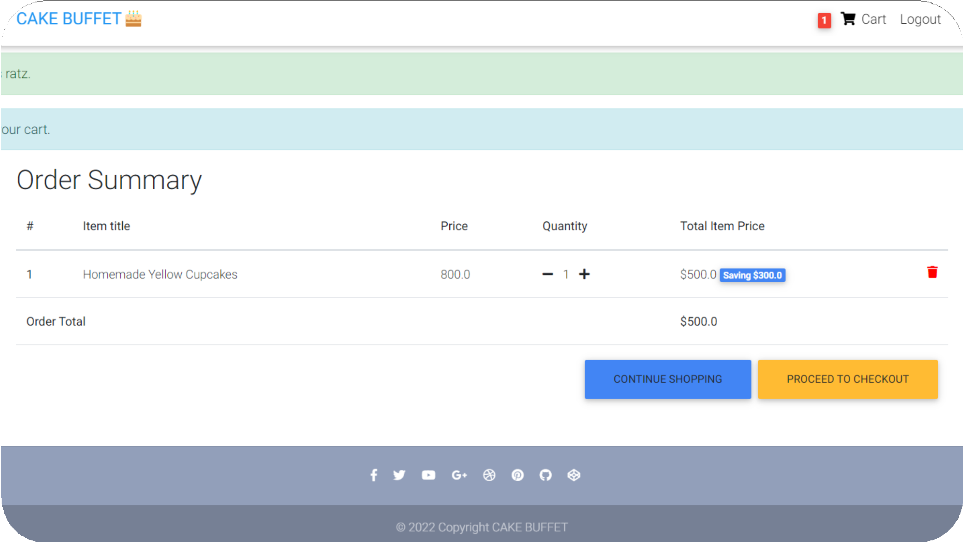
ADD TO CART

Slide 15
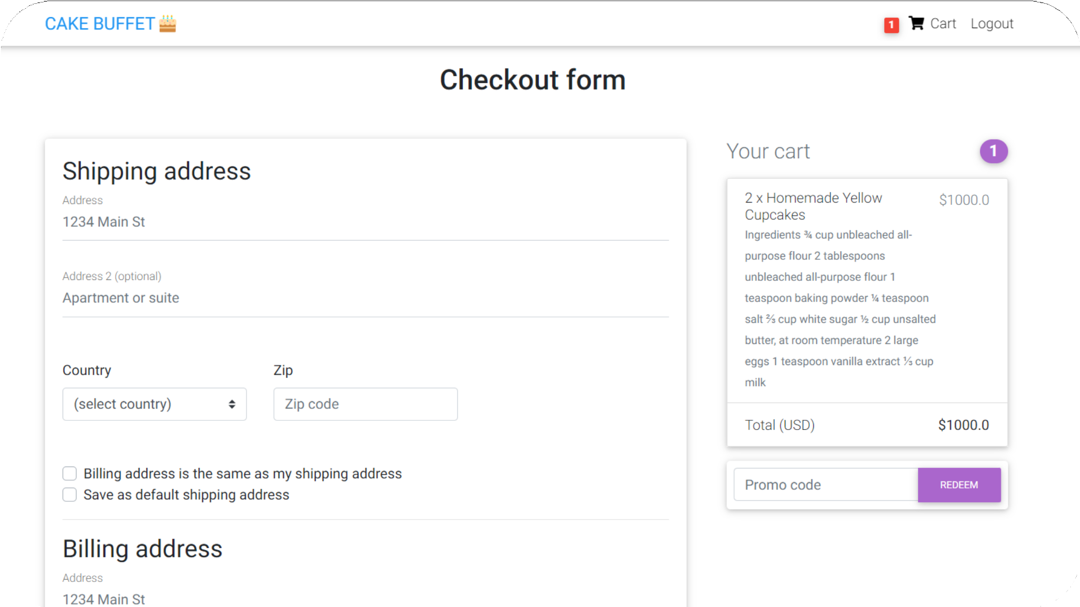
CHECKOUT
FORM AND BILLING

Slide 16
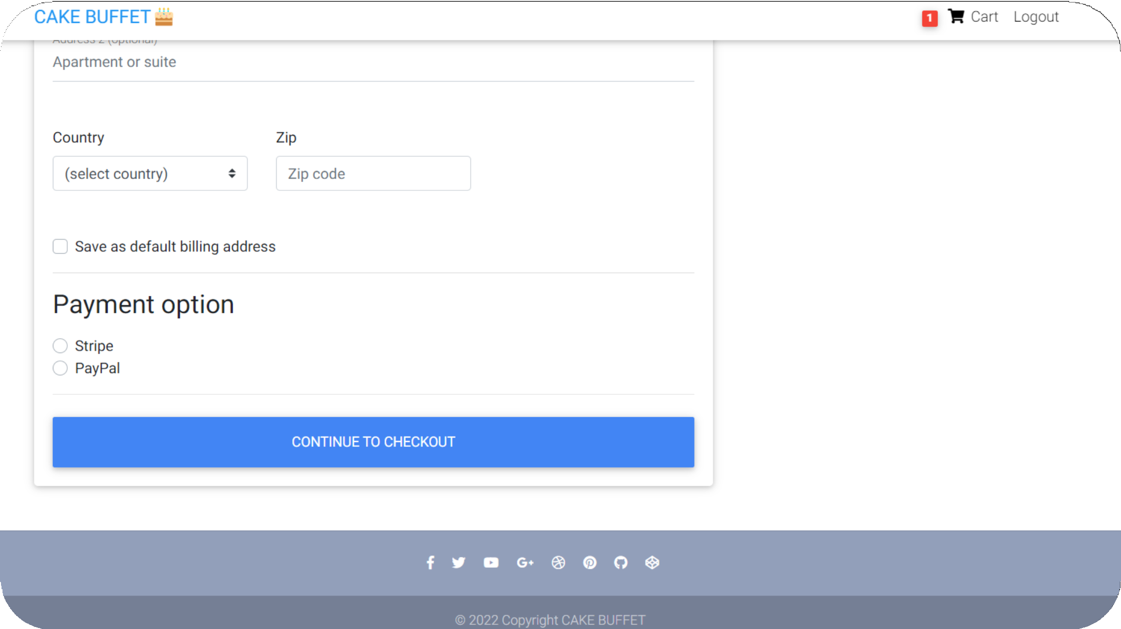
PAYMENT GATEWAY

Slide 17
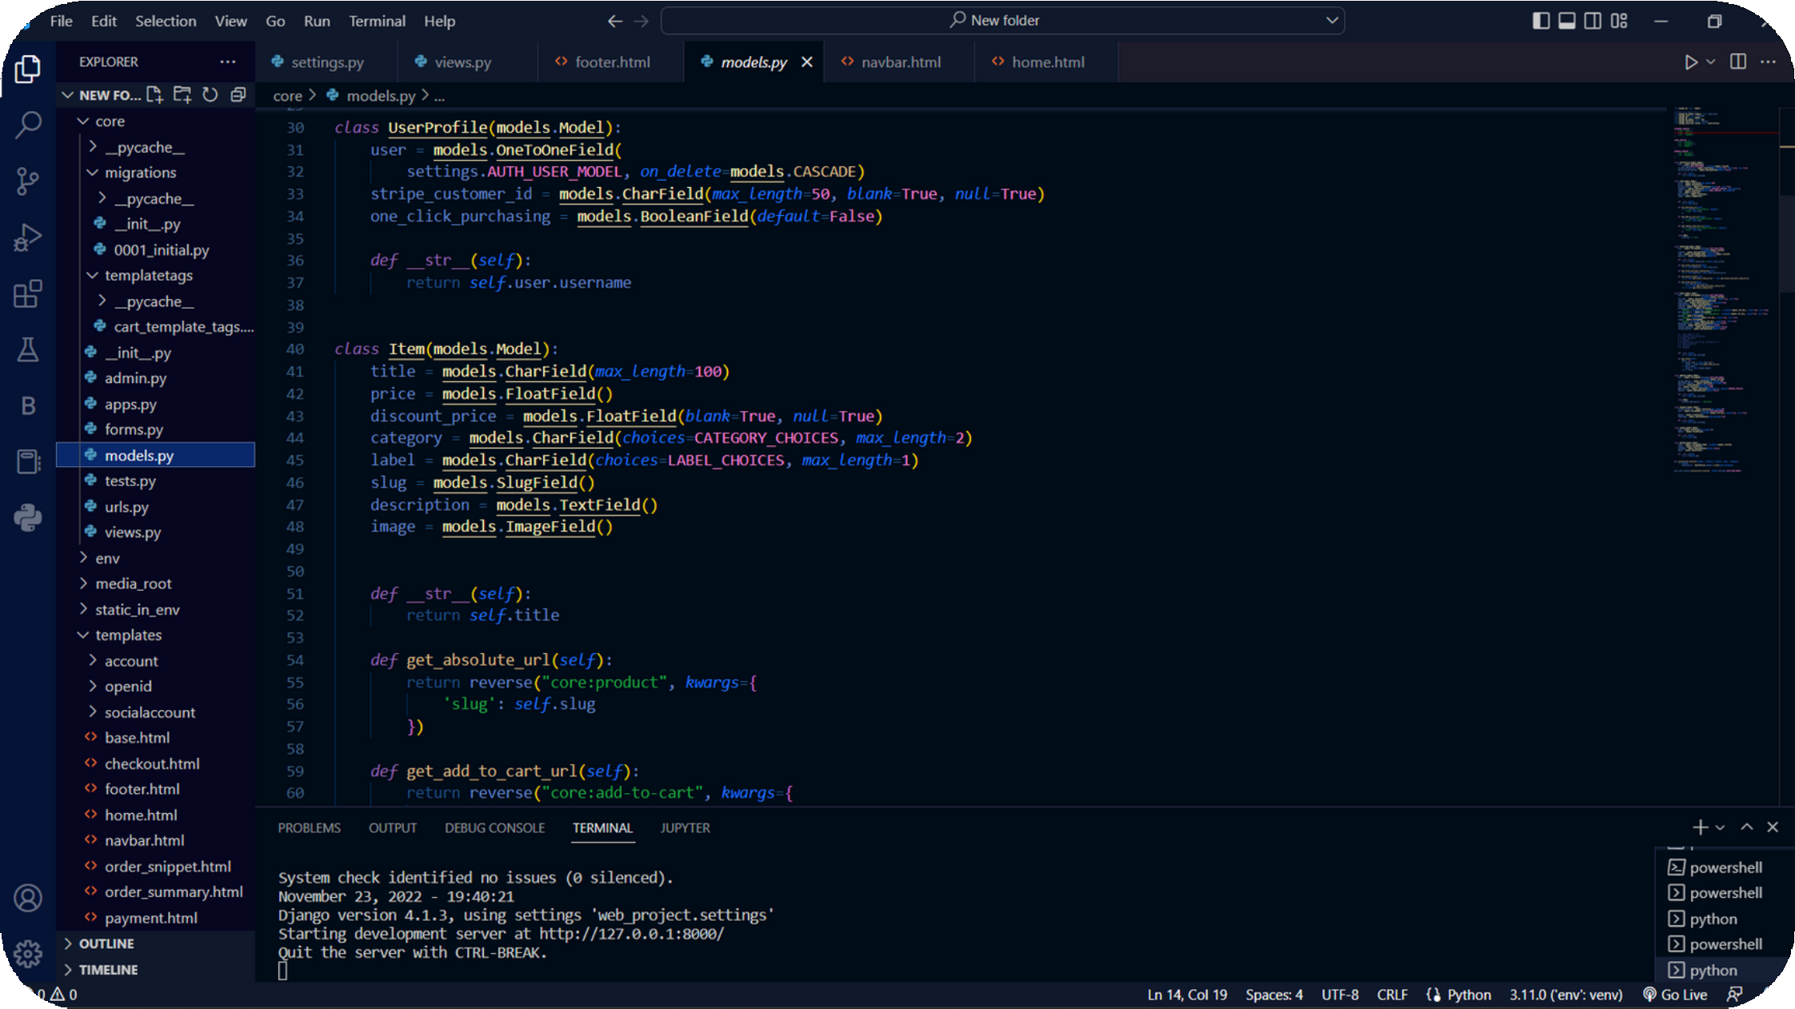
BACKEND DATABASE

Slide 18



OUR TEAM MEMBERS
RAHUL KUMAR JHA
201500546
Utkarsh Agarwal
201500757
Anushka Anil Upadhyay
201500131
Aryan Mishra
201500154
Tanu Gola
201500740

Slide 19
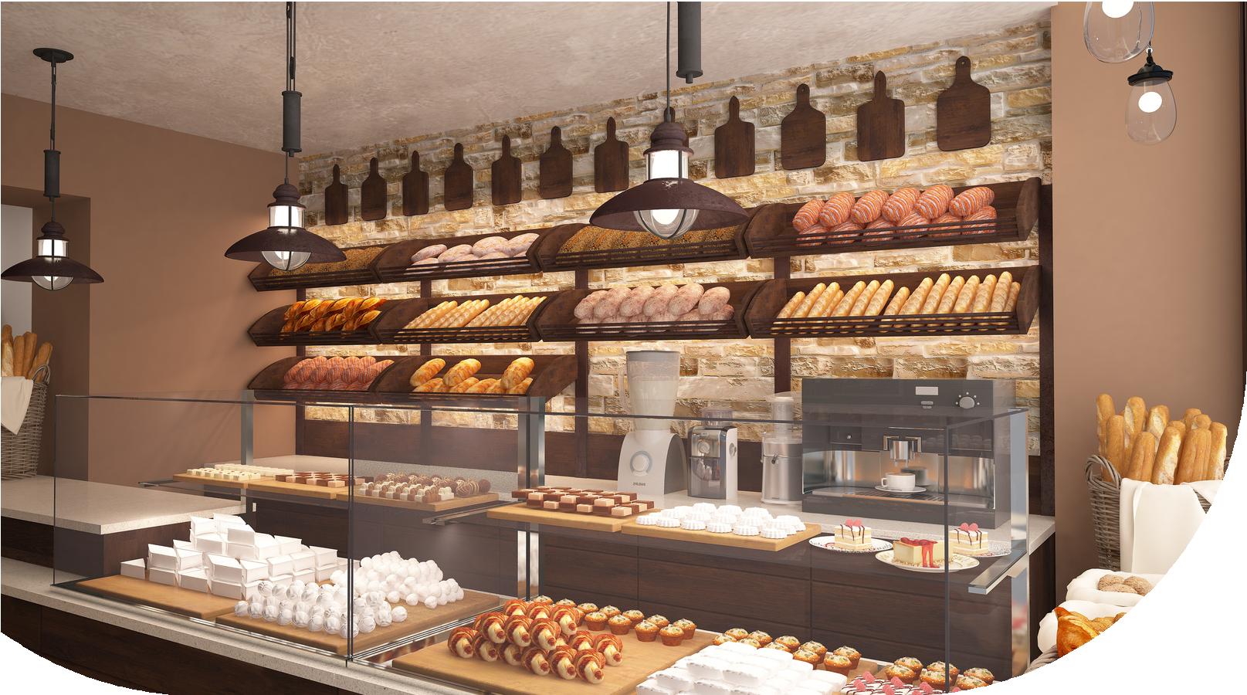
CAKE BUFFET
Sweetest Slice Of Paradise
Under The Supervision of
Mrs. Ruchi Talwar (Assistant Professor) Department of CEA GLA University, Mathur

